Slide 1
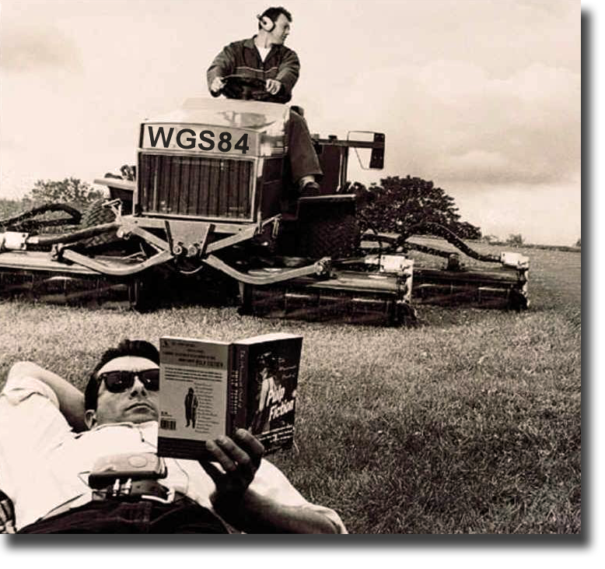
WGS84
Export
I’m in NAD83
Using ESRI Shapefile Setup
Notes:
Setup:
Planned Time: 45minutes
Class has collected, transferred, edited their own SSF data for the first time. Now its time to export. This presentation uses its own set of data, while students follow along with their own data. There is a brief introduction to Datums – at least introduces the topic which is later presented again in the Datums and Coordinate Systems Presentation
Before starting ask everyone to open PFO.
Now that you have finished differentially correcting and editing your rover file you are ready to export it in the format appropriate to your GIS, which is ArcGIS. I’m going to guide you through the process. So this is both the title and the objective for this portion of the course. My goal while going through the material for the first time is to limit the content rather than attempt to explain everything. I will be showing you one way to accomplish the objective. Please note there is much more variety and power available in the Export Utility than we are likely to explore today.
You are welcome to ask questions.
Let’s begin!

Slide 2
STEPS
Prepare GPS project in PFO
GPS Receiver Camera Configuration
Collect GPS field data
Transfer data to PC
PostProcess
Transfer data to GPS
Create Project Folder
Set Units
Edit Data Dictionary
Studio File
Make Connection
Data Dictionary
Studio File
Background Data
Receiver Configuration
Camera Setup
Satellite Planning
Check/Verify Files
Differential Correction
Edit Corrected File
Export to KMZ / GIS
GeoJot+ Processing
Make Connection
SSF File
Photos
Points, Lines, Areas
Assign Attributes
Take Photos
Navigate
Notes:
Plotter in print shop, paper is 42 inches wide
Directions for sending to plotter
Powerpoint/Print
uncheck frame, select slides
select plotter. Set to 42”
Properties / layout-Landscape / Advanced /Paper-Output/Paper Size/ 42” x 60”
Preview – if slide doesn’t fill up paper / Options/Scale to Fit Paper

Slide 3
Change Log
2019 txt to log file format. Minor cleanup
2016
New export in options (photos)
Removed requirement to store all GDB exports on C:drive. Bug fixed.
WGS84 updated to G(1762)
Added KMZ Steps
2015
Since CORS Stations are now using a NEW Reference Frame we must alter our Datum choice for transforming to shape or geodatabase.
Updated GDB export section
Notes:
Overview
Exporting is the final step in a traditional Pathfinder Office workflow that sends data to your Park’s GIS specialist
or GIS liaison. The analogy of “garbage in, garbage out” applies here. The work-flow process is outlined below:
• Setting up appropriate GPS quality filters on the datalogger;
• Differentially correcting rover files using the Trimble Differential Utility or accepting Real-Time diff. sources;
• Good editing techniques to remove GPS outliers, check attributes and finally;
• Export to GIS formats

Slide 4
Export To GIS
ESRI Shapefile
ESRI File Geodatabase
Click Here to proceed to File Geodatabase Export

Slide 5
Objective
ESRI Shapefile
Pathfinder Office
.shx - index
.shp - vector data
.dbf - attribute name
attribute value
.prj – projection file
(Each Feature Name)
.ssf (cor)
(All Features)
+
*.log + *.txt Information files
Notes:
Objective of this section is to take a COR file (an SSF file that has been differentially corrected) to an ESRI data format called shapefile.
The Shapefile format is a universal data exchange format that must be comprised of at least 3 files.
Each feature name in the DDF is translated to a unique shapefile.
The INF and TXT files found in the export directory will house metadata or information regarding the Export parameters. These are really important files.
Lets Get started.
Ssf - Standard Storage Format
Shx creates an index out of the vector and attribute files (just like index at back of a book) so that when a search is performed, the program doesn’t have to search the entire database, it goes to the index

Slide 6
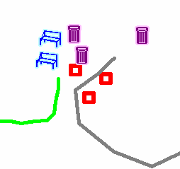
Map View of Rover File
1 Trimble File
(5 Feature Names)
20 ArcGIS Files
+
2 information files(*.log, *.txt)
Notes:
The orange box reminds us that although there is only 1 Trimble file - there's a lot going on within that file. It includes 5 Feature names that are in the data dictionary and are displayed according to the map legend. The map shows that there can be more than one feature for each feature name - in fact there are a total of 10 features on the map. Back in the orange box, there's the reminder that these 5 feature names (not the 10 features shown on the map) are going to turn into 15 files plus a couple extra.
Overview of a Trimble File and the corresponding ArcGIS files

Slide 7
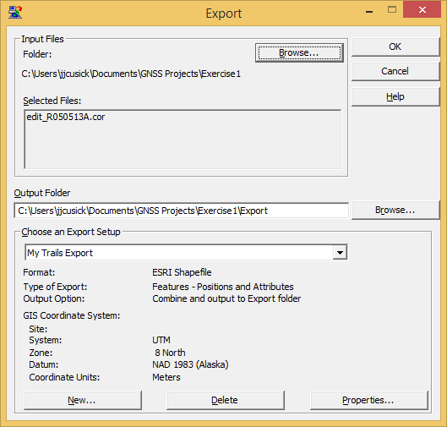
Summary
Input Files
Output Files
Export Setup
Notes:
This shows a My Parks Export Setting.

Slide 8
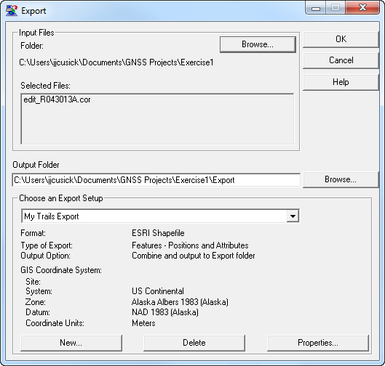
Summary
Input Files
Output Files
Export Setup
Notes:
This shows a My Parks Export Setting.

Slide 9
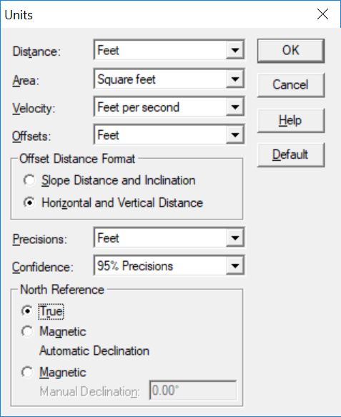
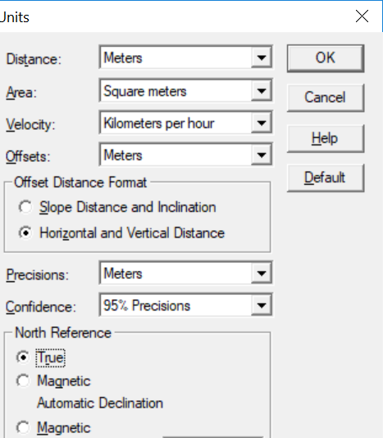
Check UNITS!
For Trails and Buildings Statue Units
For Most Other work – Metric Units
Units affect export attributes:
GPS_Length, GPS_Area,
GPS_Perimeter
Using one type of unit is good practice. Distance units = Precision units
Notes:
Overall Pathfinder Settings. These settings are crucial to check on all systems. Since UNITS and TIME are
critical in Export check these settings before launching the export utility.
Units
Access the settings by launching Pathfinder Office and selecting Options Menu.
ABOVE ALL, DON’T MIX UNITS HERE.
Set Distance, Area, Velocity and Offsets to feet or metric. Set the Precisions level to feet or meters and 95% Confidence
interval. Set North Reference Offsets to True.

Slide 10
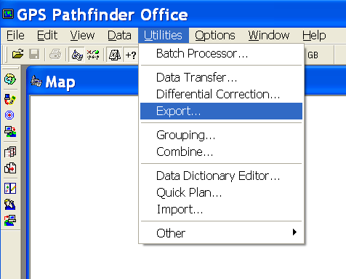
Open Export Utility
Notes:
Launching the Export Utility

Slide 11
Input Files
Notes:
If you had a rover file in the map view, it will automatically be selected in the top box. Otherwise, you will have to Browse to retrieve the file.
Note to Instructor: More than likely the file will be called “Edit or e_Rovername”

Slide 12
Output Folder
Notes:
Automatically, this output folder / Export is used.

Slide 13
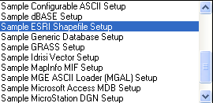
Export Setup
Select Sample ESRI Shapefile Setup
Notes:
Instructors: First time PFO users will default to other sample.
Choose the Sample ESRI shapefile setup.
Setups are examples that you can use, lets make a New Setup to use for class.

Slide 14
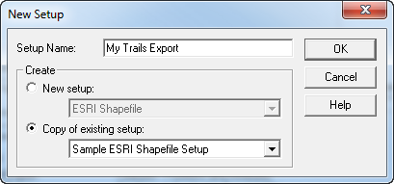
Create an Export Setup
Setup Name: My Trails Export Settings
Notes:
This is an example for Trail mapping.

Slide 15
About Export Setup
Added to drop down menu
Stored in Registry
Available only to User who created it
Can be used in the Batch Processor to automate Workflows
Notes:
GPS Pathfinder Office Software: Copying Settings to Different Computers
This document describes how to copy project definition settings, batch processor settings, data transfer device settings, and import and export settings for the Trimble® GPS Pathfinder® Office software to other computers.
All the settings for the GPS Pathfinder Office software are stored in the Microsoft® Windows® Registry. To copy the software settings to a different computer implies that you will copy parts of the Windows Registry.
Procedures
Warning: Make sure that the GPS Pathfinder Office software is not running while you are carrying out these procedures.
Exporting a (.reg) file that contains the PFO settings from the Windows Registry
1. To start the Windows Registry, select Start / Programs / Accessories / Command Prompt, enter regedit and then press the Enter key.
2. Navigate to one of the following:
• HKEY_CURRENT_USER\Software\Trimble\Pathfinder\Common\Projects
• HKEY_CURRENT_USER\Software\Trimble\Pathfinder\Office\Batch Processor
• HKEY_CURRENT_USER\Software\Trimble\Remote Device Manager\GISDatalogger
• HKEY_CURRENT_USER\Software\Trimble\Pathfinder\Office\Import
• HKEY_CURRENT_USER\Software\Trimble\Pathfinder\Office\Export
3. Right-click on the subfolder and then select Export from the menu.
Note: You must export each setting type separately. If you want to transfer the project definitions, you also need to copy the folder in which the projects are stored to the new computer.
4. Give the (.reg) file a name and save it in a folder.
Installing the registry setup on a different computer
Warning: If you carry out this procedure, you will lose any other setups that have been created on this computer.
1. Copy the file to the other computer.
2. Double-click the file to install it in the Windows Registry. You may need to reboot the computer.
www.

Slide 16
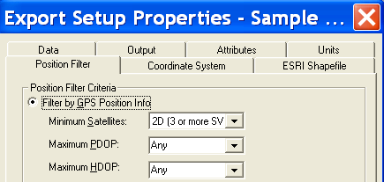
Review Properties Tabs

Slide 17
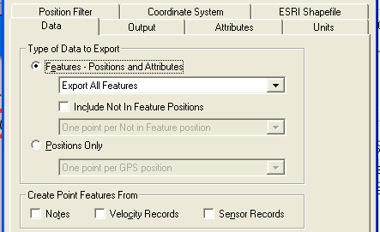
Data Tab
If collected on datalogger, represent “breadcrumb trail”
Explodes all features into positions
Notes:
Data tab: In the Type of Data to Export group, select the Features / Positions and Attributes option: - this will
export all features and attribute information.
Tip: Include Not In
Feature Positions will
create a POSNPT.shp
file that represents Not
in feature positions. Not
in Feature positions are
like breadcrumbs, but
must be activated in
TerraSync.

Slide 18
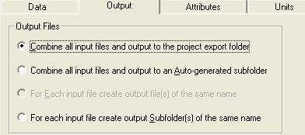
Output Tab: 1st Option
Use this option for training. See Supplemental Materials for results of 2nd and 3rd options in order to avoid overwriting files
Notes:
Output tab In the Output Files group, select Combine all input files and output to the project export folder
option. This will dump all the shapefiles in one folder at the root of the Export directory. Running export
multiple times will cause these files to be overwritten. Selecting the second option autogenerates a unique
folder for each export session.
NOTE: In many cases, you run export a couple times to get the settings just right. When using the top option,
you will overwrite your previous shapes. That’s a Good thing for file management. In some cases where you
want to export multiple days of data (3 days of shapes, representing 3 days of work), then the second or third
option is a better option. Downside, is your managing multiple folders of shapes. File management will begin to be
a problem. Use this tool for managing data in a Project Folder:
http://165.83.62.205/rgr/akgis/documents/GPS/Professional/GPS_Project_Directory_Enhancer.zip

Slide 19
Option 1: Input and Output to Export Folder

Slide 20
Output Tab: File Attribute Paths
Integrated Cameras only
Three choices to store photos relative to your GIS files
Choice depends on your hyperlink storage system

Slide 21
File Attribute Paths - DEFAULT
Stores relative path to the original download folder in GIS

Slide 22
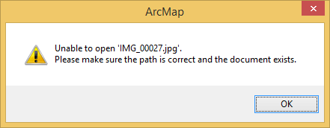
File Attribute Paths: File Name Only
Stores picture based on file name set in TerraSync or Camera App
Hyperlink won’t automatically work in ArcGIS

Slide 23
File Attribute Paths: Custom Folder
Best Option
Stores pictures in custom location, and allows grouping by feature
Likely the Option you will use most often.

Slide 24
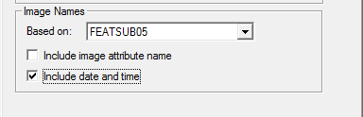
File Attribute Paths TIPS
Set a Custom Folder for permanent photo storage
File Names are controlled in the Data Dictionary Default Settings for a Feature
Image Name Basis is very powerful
Make sure your attributes are unique. Include date and time.
This example would create a unique JPG name for every External Furnishing: Benches, Bike racks etc.

Slide 25
Output Tab: Conversion File
New in 2016!
Concatenate attribute based on others
Exclude attributes on export
Replace code values based on a new list

Slide 26
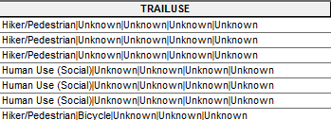
Example for Trails
Excludes attributes you did not collect. Exposes only External Furnishings and Photo Points
For Trails: Creates a TRAILUSE Field concatenates multiple trail uses with a | separator

Slide 27
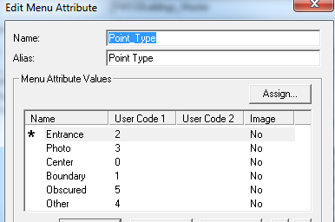
Attributes Tab: Coded Values
Trails!
Check Attribute Values when Codes are not used in DDF
Buildings!
Check Code Value when Codes are stored in the DDF
Notes:
Attributes tab: Export Menu Attributes As Attribute Value will meet the needs for those who did not use Code
values in the data dictionary step. By selecting Attribute Values, you will get the values that you filled out in
TerraSync for a menu choice.
For the novice it may be easier to export lengths and areas because it is too difficult to calculate these values in ArcGIS. For the more skilled, calculating the values in ArcGIS is not a problem.
If you export these values into ArcGiS and then calculate in ArcGis, there will be 2 sets of values in ArcGIS, which could be confusing to people; why are there 2 sets of values, why aren’t they the same, which one is correct and why….

Slide 28
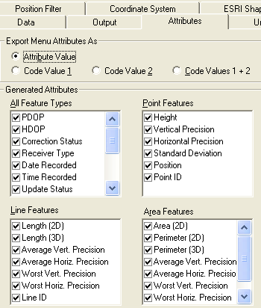
Attributes Tab
For training purposes – export all attributes
For geotagging - Date/Time/GPS Seconds must be selected
Notes:
For the novice it may be easier to export lengths and areas because it is too difficult to calculate these values in ArcGIS. For the more skilled, calculating the values in ArcGIS is not a problem.
If you export these values into ArcGiS and then calculate in ArcGis, there will be 2 sets of values in ArcGIS, which could be confusing to people; why are there 2 sets of values, why aren’t they the same, which one is correct and why….

Slide 29
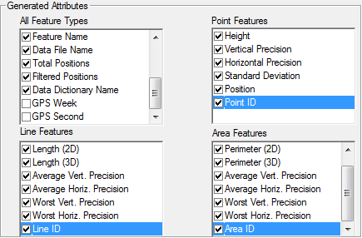
continue . . . Attributes
Not Necessary
Notes:
Generated Attributes: For most jobs, there you can choose to export all auto-generated attributes. You can
always cull them out later, or set up your geodatabase to not accept them during loading. You may opt to
export GPS lengths and area, but they are static at time of creation and will not update when editing. When in
a Geodatabaese shape length and area are dynamic, so be careful when carrying the area and length
attributes forward. Editing in
TIP: These are all attributes
generated by Trimble “for free”.
You may choose not to generate
these attributes but attributes like
PDOP are feature-specific
quality estimates that provide
metadata to your corporate GIS
structure. the GIS will produce different results between the static and dynamic lengths.

Slide 30
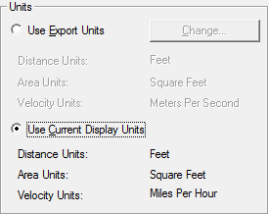
Units Tab
Click Change if Units are not Statue
Units affect shapefile attributes:
GPS_Length, GPS_Area,
GPS_Perimeter
Notes:
Units Tab: Units are set to match the way you want lengths, areas, distances and errors expressed in your
GIS. These are independent of projection units. We would recommend that you use metric units. By
selecting meters you are also using the same units that we set up in Pathfinder Office’s Units selection. See
section on overall settings here.

Slide 31
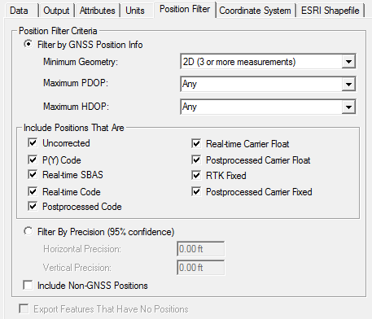
Position Filter Tab
Check when diff. correction is less than 100%
Non GPS Positions: not collected by a rover, created in Pathfinder Office or digitized in TerraSync
Notes:
Position Filter Tab: Select the following options. Include 3D (4 or more SVs) for the minimum satellites to
ensure the highest quality data. You may have to alter this to 2D under severe GPS conditions like heavy
canopy (NOTE: only GeoExplorer 3 and XR’s have capability of collecting in 2D). Include Non GPS positions
option refers to those datatypes that are not collected by the rover (this may include positions you created
while editing in PFO).

Slide 32
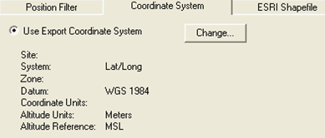
Coordinate System Tab
Controls how Pathfinder Office transforms GPS data into the coordinate system of your choosing.
Notes:
This tab controls how Pathfinder Office transforms and projects GPS data into the coordinate system of your choosing. In many cases you will need to change the default settings.
Coordinate System Tab – For All Parks Except SouthEast Alaska Depending on the Differential sources used
you may have to alter the System and Datum choice. If you used a CORS differential base station, WAAS or differential site, then you will have specific coordinates to export too.
Click the Change Button. Alter the System, Zone, Altitude and Coordinate Units as below.

Slide 33
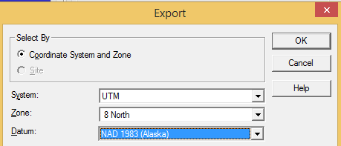
Coordinate System / Datum
UTM 8 North NAD 1983(Alaska)
huh?
Why so many NAD 1983’s?
Notes:
Select the System and Zone to match your park location. This is often easily confirmed with your park or regional GIS coordinator.
What does tend to get confusing is selecting the datum. The Datum choice for this class is going to be NAD 1983 (Conus) CORS96. Yet this is one of at least 6 versions of “NAD83”.
Does this really make a difference? Well the next few slides were going to investigate more closely the issue of datums and how to select the appropriate one for obtaining true “submeter”.

Slide 34
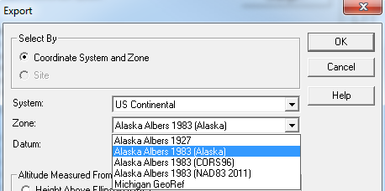
Coordinate System / Datum
US Continental / Alaska Albers 1983 (Alaska)
huh?
Why so many NAD 1983’s?
Notes:
Select the System and Zone to match your park location. This is often easily confirmed with your park or regional GIS coordinator.
What does tend to get confusing is selecting the datum. The Datum choice for this class is going to be NAD 1983 (Conus) CORS96. Yet this is one of at least 6 versions of “NAD83”.
Does this really make a difference? Well the next few slides were going to investigate more closely the issue of datums and how to select the appropriate one for obtaining true “submeter”.

Slide 35
Datum Shifts
Datum Shifts
#1 reason for mismatching GPS / GIS data is…
WGS84
I’m in NAD83
Mismatching
Datums
Notes:
# 1 reason for mismatching GPS and GIS data is the mismatching of datums.

Slide 36
Common Datums
- Out dated – pre GPS
NAD83
WGS84
ITRF
IGS08
- national standard
- used for GPS
world standard
world standard today
NAD27
ftp://itrf.ensg.ign.fr/pub/itrf/WGS84.TXT
Notes:
Explain a datum
In the US, GIS personnel are most likely to encounter three horizontal reference map Datums NAD27
NAD83
WGS84
ITRF00 – Global geode
From Hemisphere GNSS:
"ITRF2008 is the most current reference frame realization of the International Terrestrial Reference System (ITRS), a responsibility of the International Earth Rotation and Reference Systems Service (IERS). Previously to ITRF2008, ITRF2005 was the official realization published by IERS. The ITRF2005 and ITRF2008 realizations agree within just a few millimeters (see transformation parameters here).
The ITRF realizations (e.g. ITRF2008) are compatible with the modern, GPS-based, versions of WGS84 within about a decimeter. This applies to WGS84 version G730 onwards. The latest version of the WGS84 (version G1762) was generated using ITRF2008 positions for reference sites, yielding into a possible agreement at centimeter level between these two modern frames (see reference here)."
tic system used mainly in scientific studies.

Slide 37
Over Time Datums Grew Apart
1986
Today
NAD83 = WGS84
NAD 83 ≠ WGS84
Anchorage
&
Skagway
1.3 meters (4.2 feet)
WGS84 = IGS08
Notes:
This slide is designed to show why there is a horizontal difference between the latest realizations of WGS84/ITRF00 and NAD83.
When NAD83 was rolled out in 1986, geodesists used every available observation to set the datum starting point. This included GPS observations. The geocentric (center of earth) position was known to a meter or so.
Then thru time, as measurements improved, GPS observations improved, more was learned about the center of the earth or geocentric center of earth.
Today, due to refinements, we now have measured the center of the earth within a cm precision level. Coupled with better knowledge of the earth center and better observations, the latest NAD83 is not equal to WGS84. In fact for Manassas Virginia, these differ horizontally about 0.9 meters or 2.9 feet.
Not recognizing these differences can confound storage of high quality GPS data that are submeter accurate.

Slide 38
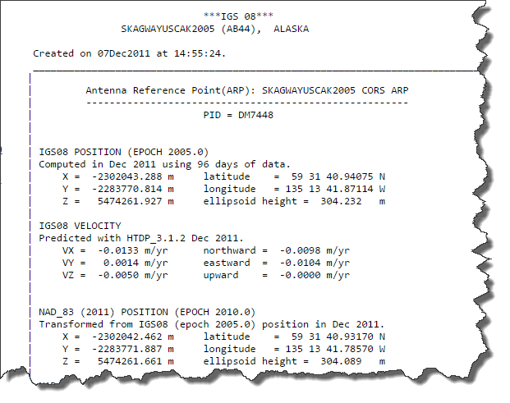
Datum of Base Station Becomes Datum of Corrected File
Reference position from base file is NAD83 (2011),
therefore post-processed file is now NAD83 (2011)

Slide 39
Today, You Have to Go Back
NAD83
NAD 83 (2011) EPOCH 2010.0
WGS84/IGS08
Anchorage
&
Skagway
1.3 meters (4.2 feet)
Notes:
Reverse the sequence…

Slide 40
Say it Another Way
We are Exporting using a new Datum
This is because CORS has switched to a new form of NAD83. Its called NAD83 (2011) and they embed the published form of NAD83 in the Rinex header of the BASE file
During Export we want to do “nothing” to our COR file already in NAD83 (2011).

Slide 41
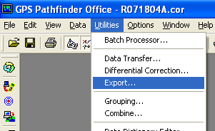
Datums Change
IGS08/WGS84
Satellites
NAD83 (2011)
CORS Base Provider
Export Using
NAD 1983 (Alaska)
GIS
SSF
COR
SHP or GDB

Slide 42
Watch Out ProXR / GeoBeacons!
NAD83 (CONUS) CORS96
Real-time
Base Provider
Export using
NAD83(Alaska)
No post-processing - real-time accepted
GIS
SSF
SSF
SHP
Notes:
42

Slide 43
Which Datum Are You In?
WGS84 = IGS08
NAD83 (2011)
- CORS Post Processed when using position from base station list
- Autonomous GPS
- WAAS
- CORS Post Processed when using position from downloaded base files
- NDGPS (Beacon)
- OMNISTAR (Satellite)
Links to learn more:
ftp://itrf.ensg.ign.fr/pub/itrf/WGS84.TXT
WGS84 Current Standard
Notes:
If you followed the steps in Differential Correction, your are IN NAD83 (2011 Already).

Slide 44
Coordinate System / Datum Settings
Cool!
Notes:
At this time, set the System, Zone to the Training center recommended coordinate system. The Datum choice will be Alaska Albers 1983 (Alaska). This datum will only be available in PFO 5.4 and beyond. Earlier PFO versions will need to add the datum in – Trimble support site for the white paper on NAD83 Reference Frame.
Now – we need to take a moment and learn about Datums and how GPS users must confront this often confusing subject

Slide 45
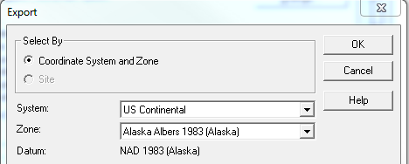
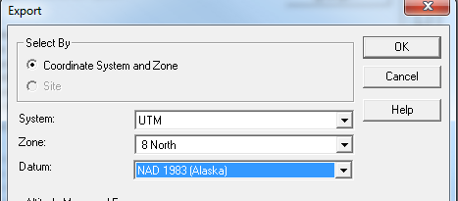
Coordinate System and Datum
All Parks in Alaska except South East Alaska
Only Parks
KLGO, GLBA, SITK
Notes:
Here are the two settings for 2013

Slide 46
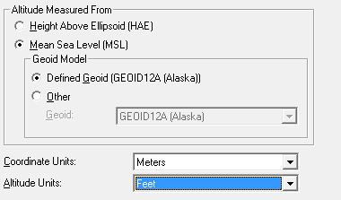
Coordinate System – Geoid 12A
HAE is precise, but difficult to relate to
You Must Select GEOID12A (Alaska).
Keep in Meters. Never Change. All CS in Alaska are meters
Try not to mismatch units-stay consistent with UNITS settings – Slide 8
Notes:
Use Geoid 12A for Alaska

Slide 47
Coordinate System Tab (cont'd)
XYZ and M values passed into ArcGIS – allows creation of 3D shapes
Notes:
the dictionary definition for M value
1. Vertex attributes that are stored with x,y point coordinates in ESRI's Geometry Engine. Every type of geometry (point, polyline, polygon, and so on) can have attributes for every vertex.
2. In linear referencing, measure values that may be added to linear features to perform dynamic segmentation. In linear referencing, m-values are used on vertices to imply a measurement along a linear feature. The m-value allows a location along a line to be found.

Slide 48
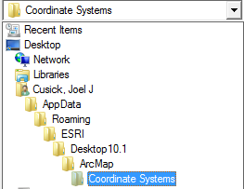
Browse to ArcGIS 10.X Coordinate Systems Folder
C:\Users<login name>
\AppData\Roaming\ESRI\Desktop10.3\ ArcMap\Coordinate Systems\
Notes:
Here is how you assign a PRJ.
First open Arcmap. Save the Alaska Albers Coordinate system (NAD83 (2011) as a Favorite.
Then this path will work.

Slide 49
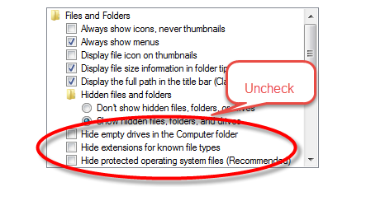
Can’t see AppData?
If you don’t see AppData, you must expose them from Windows Explorer
Launch Windows Explorer
Select Tools/ Folder Options
View Tab.
Uncheck the 3 “Hide boxes
Apply
OK
Notes:
If the coordinate system is not here, you must first make it a Favorite.

Slide 50
Select Projection
Notes:
If the coordinate system is not here, you must first make it a Favorite.

Slide 51
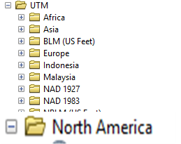
If NAD83 (2011) UTM Zone 8N.prj is not Present
Launch ArcMap
Click Properties of Data Frame
Select Coordinate System Tab
Select / Projected Coordinate Systems / UTM/ North America
NAD83 (2011) UTM Zone 8N.prj
Select Favorites
Click Add To Favorites

Slide 52
Select Projection
Notes:
If the coordinate system is not here, you must first make it a Favorite.

Slide 53
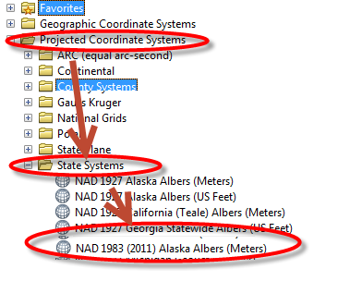
If Alaska Albers NAD83 (2011) is not Present
Launch ArcMap
Click Properties of Data Frame
Select Coordinate System Tab
Select / Projected Coordinate Systems / State Systems /
Alaska Albers NAD83 (2011).prj
Select Favorites
Click Add To Favorites

Slide 54
Select Projection
Once you have added NAD83(2011) UTM Zone 8 North as a Favorite in ArcGIS the file is stored on your Harddrive.
Proceed to next slide
If you Don’t have ArcMap, these other locations
CD - /Coordinate Systems
W:drive W:\ARO\GIS\GPS_Support\2019Courses
Notes:
If the coordinate system is not here, you must first make it a Favorite.

Slide 55
ESRI Shapefile Tab
Check, if using Tracking Analyst

Slide 57
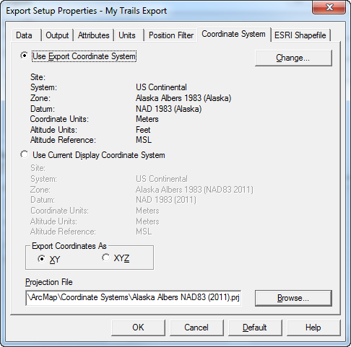

Slide 58
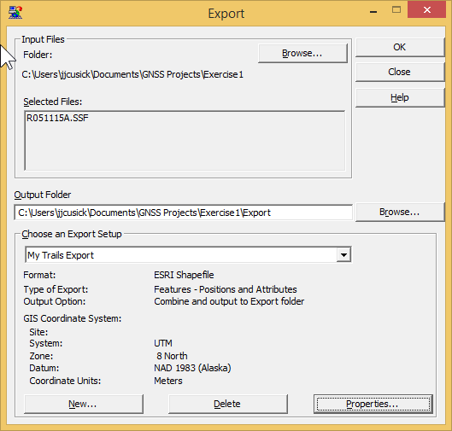
Create Shapefile Export Files
Notes:
Here is what your screen will look like before you press Export.
If you were in SouthEast Alaska, it would have UTM as the System, Zone 8 North and NAD 1983 (Alaska) as the datum.

Slide 59
Create Shapefile Export Files
Notes:
Here is what your screen will look like before you press Export.
If you were in SouthEast Alaska, it would have UTM as the System, Zone 8 North and NAD 1983 (Alaska) as the datum.

Slide 60
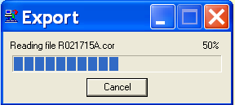
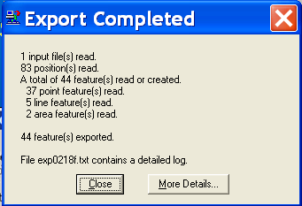
Status Windows
Reading file R041312A.cor

Slide 61
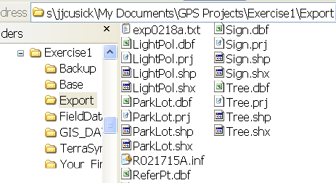
Contents of an Export Folder
Keep with shapefiles
R041312A.inf
Notes:
There is something missing.,

Slide 62
Shapefile Summary
Input Files
Output Files
Export Setup
Notes:
This shows a My Parks Export Setting.

Slide 63
Shapefile Summary
Input Files
Output Files
Export Setup
Notes:
This shows a My Parks Export Setting.

Slide 64
Shapefile Export Summary

Slide 65
STEPS
Prepare GPS project in PFO
GPS Receiver Camera Configuration
Collect GPS field data
Transfer data to PC
PostProcess
Transfer data to GPS
Create Project Folder
Set Units
Edit Data Dictionary
Studio File
Make Connection
Data Dictionary
Studio File
Background Data
Receiver Configuration
Camera Setup
Satellite Planning
Check/Verify Files
Differential Correction
Edit Corrected File
Export to KMZ / GIS
GeoJot+ Processing
Make Connection
SSF File
Photos
Points, Lines, Areas
Assign Attributes
Take Photos
Navigate
Notes:
Plotter in print shop, paper is 42 inches wide
Directions for sending to plotter
Powerpoint/Print
uncheck frame, select slides
select plotter. Set to 42”
Properties / layout-Landscape / Advanced /Paper-Output/Paper Size/ 42” x 60”
Preview – if slide doesn’t fill up paper / Options/Scale to Fit Paper

Slide 67
Export To GIS
ESRI Shapefile
ESRI File Geodatabase
Click Here to proceed to Shapefile Export

Slide 68
Change Log
You must use the XML Text for Alaska Albers CORS96. This is a bug that has not been resolved as of June 2015. (redefine GDB FC’s as Alaska Albers NAD83 (2011) in Arc
Notes:
Overview
Exporting is the final step in a traditional Pathfinder Office workflow that sends data to your Park’s GIS specialist
or GIS liaison. The analogy of “garbage in, garbage out” applies here. The work-flow process is outlined below:
• Setting up appropriate GPS quality filters on the datalogger;
• Differentially correcting rover files using the Trimble Differential Utility or accepting Real-Time diff. sources;
• Good editing techniques to remove GPS outliers, check attributes and finally;
• Export to GIS formats

Slide 69
Objective
ESRI Geodatabase
Pathfinder Office
.ssf (cor)
(All Features)
.gdb – (All Features)
+
.inf + .txt Information files
Notes:
Objective of this section is to take a COR file (an SSF file that has been differentially corrected) to an ESRI data format called shapefile.
The Shapefile format is a universal data exchange format that must be comprised of at least 3 files.
Each feature name in the DDF is translated to a unique shapefile.
The INF and TXT files found in the export directory will house metadata or information regarding the Export parameters. These are really important files.
Lets Get started.
Ssf - Standard Storage Format
Shx creates an index out of the vector and attribute files (just like index at back of a book) so that when a search is performed, the program doesn’t have to search the entire database, it goes to the index

Slide 70
Map View of Rover File
1 Trimble File
(5 Feature Names)
1 ArcGIS folder (.gdb)
+
2 information files(*inf, *txt)
Notes:
The orange box reminds us that although there is only 1 Trimble file - there's a lot going on within that file. It includes 5 Feature names that are in the data dictionary and are displayed according to the map legend. The map shows that there can be more than one feature for each feature name - in fact there are a total of 10 features on the map. Back in the orange box, there's the reminder that these 5 feature names (not the 10 features shown on the map) are going to turn into 15 files plus a couple extra.
Overview of a Trimble File and the corresponding ArcGIS files

Slide 71
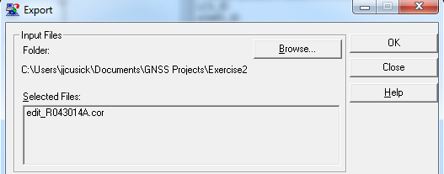
Input Files
Notes:
If you had a rover file in the map view, it will automatically be selected in the top box. Otherwise, you will have to Browse to retrieve the file.
Note to Instructor: More than likely the file will be called “Edit or e_Rovername”

Slide 72
Output Folder
Notes:
Automatically, this output folder / Export is used.

Slide 73
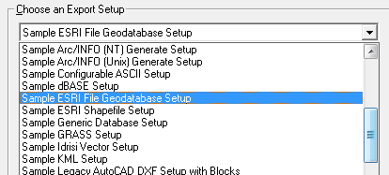
Export Setup
Select Sample ESRI File Geodatabase Setup
Notes:
Instructors: First time PFO users will default to other sample.
Choose the Sample ESRI shapefile setup.
Setups are examples that you can use, lets make a New Setup to use for class.

Slide 74
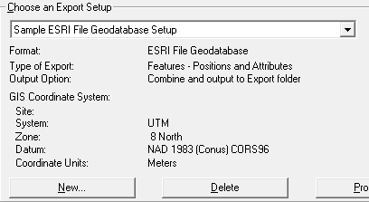
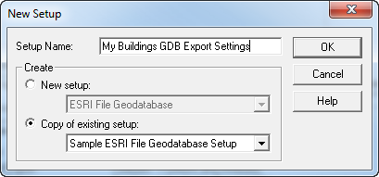
Create an Export Setup
Setup Name: My Buildings GDB Export Settings

Slide 75
About Export Setup
Added to drop down menu
Stored in Registry
Available only to User who created it
Can be used in the Batch Processor to automate Workflows
Notes:
GPS Pathfinder Office Software: Copying Settings to Different Computers
This document describes how to copy project definition settings, batch processor settings, data transfer device settings, and import and export settings for the Trimble® GPS Pathfinder® Office software to other computers.
All the settings for the GPS Pathfinder Office software are stored in the Microsoft® Windows® Registry. To copy the software settings to a different computer implies that you will copy parts of the Windows Registry.
Procedures
Warning: Make sure that the GPS Pathfinder Office software is not running while you are carrying out these procedures.
Exporting a (.reg) file that contains the PFO settings from the Windows Registry
1. To start the Windows Registry, select Start / Programs / Accessories / Command Prompt, enter regedit and then press the Enter key.
2. Navigate to one of the following:
• HKEY_CURRENT_USER\Software\Trimble\Pathfinder\Common\Projects
• HKEY_CURRENT_USER\Software\Trimble\Pathfinder\Office\Batch Processor
• HKEY_CURRENT_USER\Software\Trimble\Remote Device Manager\GISDatalogger
• HKEY_CURRENT_USER\Software\Trimble\Pathfinder\Office\Import
• HKEY_CURRENT_USER\Software\Trimble\Pathfinder\Office\Export
3. Right-click on the subfolder and then select Export from the menu.
Note: You must export each setting type separately. If you want to transfer the project definitions, you also need to copy the folder in which the projects are stored to the new computer.
4. Give the (.reg) file a name and save it in a folder.
Installing the registry setup on a different computer
Warning: If you carry out this procedure, you will lose any other setups that have been created on this computer.
1. Copy the file to the other computer.
2. Double-click the file to install it in the Windows Registry. You may need to reboot the computer.
www.

Slide 76
Review Properties Tabs

Slide 77
Data Tab
If collected on datalogger, represent “breadcrumb trail”

Slide 78
Output Tab: 1st Option
Use this option for training. See Supplemental Materials for results of 2nd and 3rd options in order to avoid overwriting files

Slide 79
Option 1: Input and Output to Export Folder

Slide 80
Attributes Tab: Coded Values
Buildings and Survey Controls – Must Check Code Value
Buildings!
Check Code Value when Codes are stored in the DDF
Notes:
For the novice it may be easier to export lengths and areas because it is too difficult to calculate these values in ArcGIS. For the more skilled, calculating the values in ArcGIS is not a problem.
If you export these values into ArcGiS and then calculate in ArcGis, there will be 2 sets of values in ArcGIS, which could be confusing to people; why are there 2 sets of values, why aren’t they the same, which one is correct and why….

Slide 81
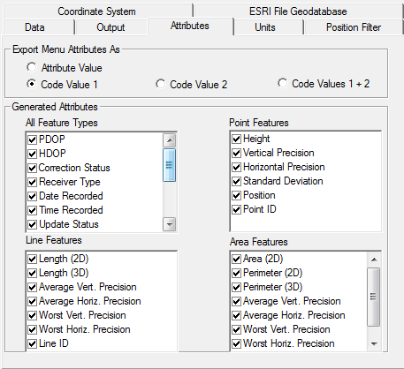
Attributes Tab
For training purposes – export all attributes
For geotagging - Date/Time/GPS Seconds must be selected
Notes:
For the novice it may be easier to export lengths and areas because it is too difficult to calculate these values in ArcGIS. For the more skilled, calculating the values in ArcGIS is not a problem.
If you export these values into ArcGiS and then calculate in ArcGis, there will be 2 sets of values in ArcGIS, which could be confusing to people; why are there 2 sets of values, why aren’t they the same, which one is correct and why….

Slide 82
continue . . . Attributes
Not Necessary

Slide 83
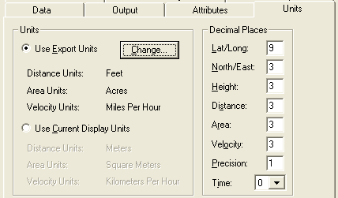
Units Tab
Units affect shapefile attributes:
GPS_Length, GPS_Area,
GPS_Perimeter

Slide 84
Position Filter Tab
Check when diff. correction is less than 100%
Non GPS Positions: not collected by a rover, created in Pathfinder Office or digitized in TerraSync

Slide 85
Coordinate System Tab
Controls how Pathfinder Office transforms GPS data into the coordinate system of your choosing.
Notes:
This tab controls how Pathfinder Office transforms and projects GPS data into the coordinate system of your choosing. In many cases you will need to change the default settings.

Slide 86
Coordinate System Dialog Window
Should see 5 choices. If not, apply PFO updates

Slide 87
Coordinate System Dialog Window
HAE is precise, but difficult to relate to
Most printed maps use MSL. When in doubt use latest Geoid model.
Try not to mismatch units-stay consistent with UNITS settings

Slide 88
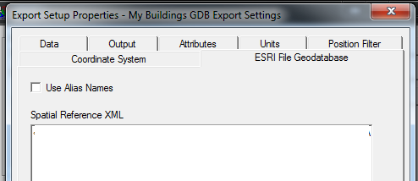
Coordinate System Tab (cont'd)
Export for buildings must not include Alias Names!
Copy and paste the spatial reference section from an XML workspace document – Next Slide contains the text.
Notes:
the dictionary definition for M value
1. Vertex attributes that are stored with x,y point coordinates in ESRI's Geometry Engine. Every type of geometry (point, polyline, polygon, and so on) can have attributes for every vertex.
2. In linear referencing, measure values that may be added to linear features to perform dynamic segmentation. In linear referencing, m-values are used on vertices to imply a measurement along a linear feature. The m-value allows a location along a line to be found.

Slide 89
<SpatialReference xsi:type="esri:ProjectedCoordinateSystem"><WKT>PROJCS["NAD_1983_CORS96_UTM_Zone_8N",GEOGCS["GCS_NAD_1983_CORS96",DATUM["D_NAD_1983_CORS96",SPHEROID["GRS_1980",6378137.0,298.257222101]],PRIMEM["Greenwich",0.0],UNIT["Degree",0.0174532925199433]],PROJECTION["Transverse_Mercator"],PARAMETER["False_Easting",500000.0],PARAMETER["False_Northing",0.0],PARAMETER["Central_Meridian",-135.0],PARAMETER["Scale_Factor",0.9996],PARAMETER["Latitude_Of_Origin",0.0],UNIT["Meter",1.0],AUTHORITY["ESRI",102408]]</WKT><XOrigin>-5120900</XOrigin><YOrigin>-9998100</YOrigin><XYScale>10000</XYScale><ZOrigin>-100000</ZOrigin><ZScale>10000</ZScale><MOrigin>-100000</MOrigin><MScale>10000</MScale><XYTolerance>0.001</XYTolerance><ZTolerance>0.001</ZTolerance><MTolerance>0.001</MTolerance><HighPrecision>true</HighPrecision><WKID>102408</WKID></SpatialReference>
For Alaska (South East AK Only) Copy and paste this block of text in the Spatial Reference XML block

Slide 90
<SpatialReference xsi:type="esri:ProjectedCoordinateSystem"><WKT>PROJCS["NAD_1983_CORS96_Alaska_Albers",GEOGCS["GCS_NAD_1983_CORS96",DATUM["D_NAD_1983_CORS96",SPHEROID["GRS_1980",6378137.0,298.257222101]],PRIMEM["Greenwich",0.0],UNIT["Degree",0.0174532925199433]],PROJECTION["Albers"],PARAMETER["False_Easting",0.0],PARAMETER["False_Northing",0.0],PARAMETER["Central_Meridian",-154.0],PARAMETER["Standard_Parallel_1",55.0],PARAMETER["Standard_Parallel_2",65.0],PARAMETER["Latitude_Of_Origin",50.0],UNIT["Meter",1.0],AUTHORITY["ESRI",102247]]</WKT><XOrigin>-13752200</XOrigin><YOrigin>-8948200</YOrigin><XYScale>10000</XYScale><ZOrigin>-100000</ZOrigin><ZScale>10000</ZScale><MOrigin>-100000</MOrigin><MScale>10000</MScale><XYTolerance>0.001</XYTolerance><ZTolerance>0.001</ZTolerance><MTolerance>0.001</MTolerance><HighPrecision>true</HighPrecision><WKID>102247</WKID></SpatialReference>
For Alaska (not SE) Copy and paste this block of text in the Spatial Reference XML block

Slide 91
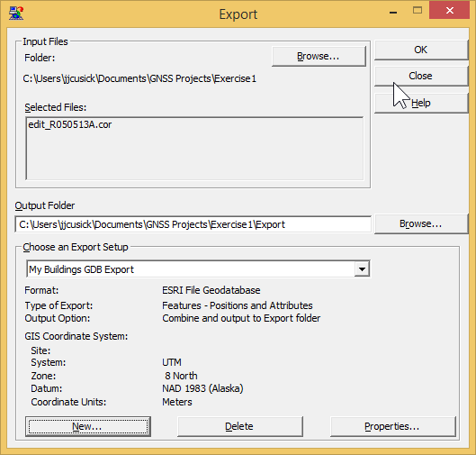
Create Export Files

Slide 92
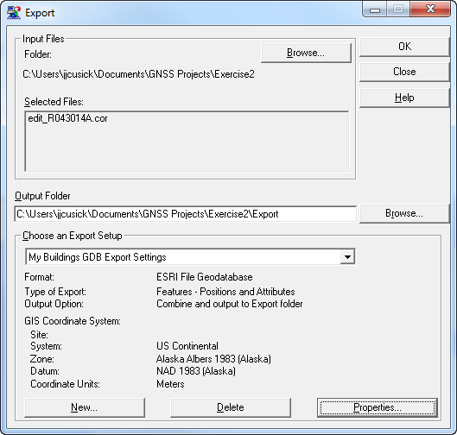
Create Export Files

Slide 93
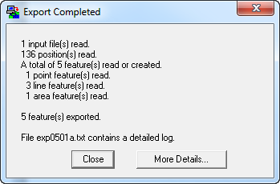
Status Windows
Reading file R041312A.cor

Slide 94
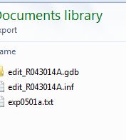
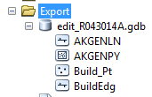
Contents of an Export Folder
The Geodatabase contains your Feature Classes
Never throw away – Metadata for the future
Notes:
There is something missing.,

Slide 95
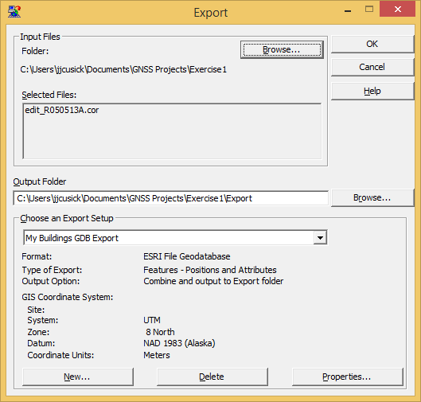
GDB Summary
Input Files
Output Files
Export Setup
Notes:
This shows a My Parks Export Setting.

Slide 96
GDB Summary
Input Files
Output Files
Export Setup
Notes:
This shows a My Parks Export Setting.

Slide 98
Supplemental Materials
Output – 2nd and 3rd Options
Notes:
GPS Pathfinder Office Software: Copying Settings to Different Computers
This document describes how to copy project definition settings, batch processor settings, data transfer device settings, and import and export settings for the Trimble® GPS Pathfinder® Office software to other computers.
All the settings for the GPS Pathfinder Office software are stored in the Microsoft® Windows® Registry. To copy the software settings to a different computer implies that you will copy parts of the Windows Registry.
Procedures
Warning: Make sure that the GPS Pathfinder Office software is not running while you are carrying out these procedures.
Exporting a (.reg) file that contains the PFO settings from the Windows Registry
1. To start the Windows Registry, select Start / Programs / Accessories / Command Prompt, enter regedit and then press the Enter key.
2. Navigate to one of the following:
• HKEY_CURRENT_USER\Software\Trimble\Pathfinder\Common\Projects
• HKEY_CURRENT_USER\Software\Trimble\Pathfinder\Office\Batch Processor
• HKEY_CURRENT_USER\Software\Trimble\Remote Device Manager\GISDatalogger
• HKEY_CURRENT_USER\Software\Trimble\Pathfinder\Office\Import
• HKEY_CURRENT_USER\Software\Trimble\Pathfinder\Office\Export
3. Right-click on the subfolder and then select Export from the menu.
Note: You must export each setting type separately. If you want to transfer the project definitions, you also need to copy the folder in which the projects are stored to the new computer.
4. Give the (.reg) file a name and save it in a folder.
Installing the registry setup on a different computer
Warning: If you carry out this procedure, you will lose any other setups that have been created on this computer.
1. Copy the file to the other computer.
2. Double-click the file to install it in the Windows Registry. You may need to reboot the computer.
www.

Slide 99
Other Output Options

Slide 100
Output Tab: 2nd Option

Slide 101
Option 2: Input and Output to Auto-Generated Subfolder
051111 = May 11th 1100 hours
Auto-generated folders reflect export time not collection time

Slide 102
Output Tab: 3rd Option

Slide 103
Option 3: Subfolder Created and Named for Each Input File
031822 = March 18, 2200 hours
Subfolders reflect collection time

