Slide 1
Corridors and Superelevations
Trimble Business Center v5.0 Training
Last Updated – November 2018

Slide 2
Superelevation Terms
Normal Cross Slope
The standard cross slope for a road in a straight section i.e. no curvature e.g. -2%
Maximum Superelevation
The cross slope at the peak of superelevation in the curve e.g. 6%
Runout and Runout Distance
The distance over which the normal cross slope e.g. -2% changes to a 0% cross slope
Is normally taken out in the straight or tangent section preceding or succeeding the curve section
Runoff and Runoff Distance
The distance over which the cross slope changes from 0% to the maximum superelevation
Normally occurs through the spiral section leading into the Arc section of the road
Where no spiral exists i.e. in a straight – arc – straight combination, user will define how much of the runoff length will occur in the Arc or Curve section as a percentage of the total runoff. i.e. for a 0% to 6% superelevation change, if user enters 50% in the curve, then -2 to +3% will be in the straight section and +3 to +6% will be in the Arc or Curve section
Compound Maximum
The distance between superelevation elements on adjacent curves in the same direction (right or left) beneath which the current super will merge into a single compound superelevation with the previous super (stops the road repeatedly changing cross slope) (basically maintains the super elevation over a longer distance filling the gap between supers) (Note: Looks back to previous curve). Note measured from End of Super to start of Start of Super
Reverse Maximum
The distance between superelevation elements on adjacent curves which reverse direction (right to left etc.) beneath which the current super will merge into a single transition to the previous super (basically reduces the rate of change of slope through the area between curves) (Note: Looks back to previous curve)

Slide 3
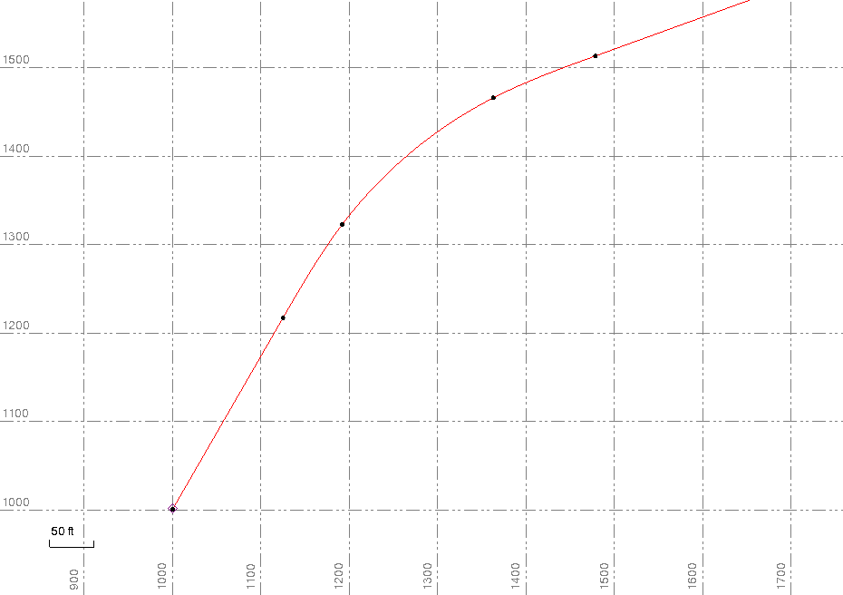
Superelevation With Spirals
Max Superelevation
Runoff
5
Runoff
4
4
5
3
2
3
Runout
2
Normal Cross Slope
1
1

Slide 4
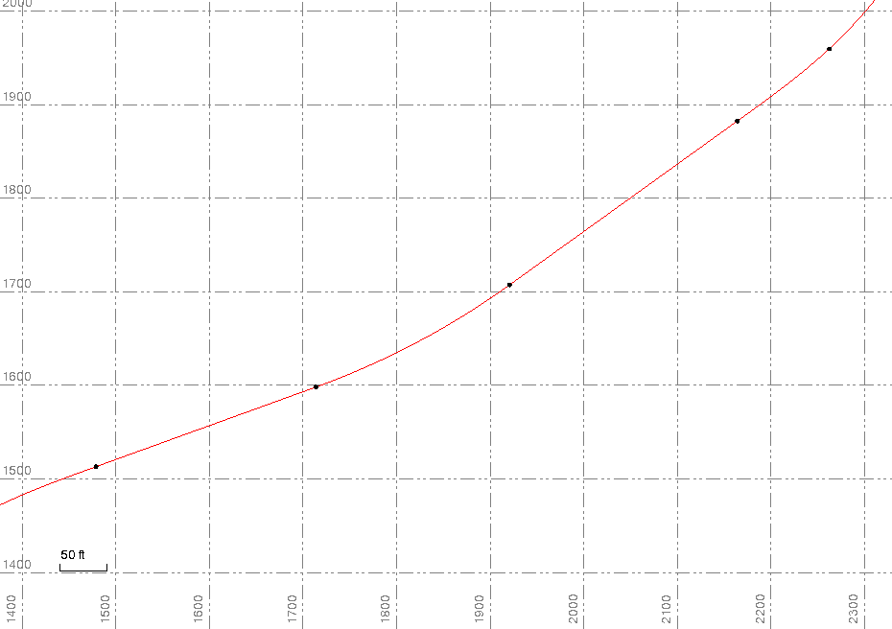
Superelevations With Arcs Only
Max Superelevation
Runoff
5
Runoff
4
2
4
5
3
3
Runout
1
2
Normal Cross Slope
Note: Runout is always in Straight Section
Note: Runoff is 50% in Straight and 50% in Curve Section
Note: The Percentage of Runoff in the Curve Varies
1

Slide 5
Notes on Superelevations In Arcs
For superelevations through Arc only sections
All runout (e.g. -2% to 0%) will be in the straight or tangent section.
Additionally a % of the runoff (e.g. 0% to 6%) will also be in the straight section
Typically 66% of the superelevation will be in the straight or tangent section and 33% in the arc itself. In this scenario -2% to +4% would be in tangent and +4% to +6% in the arc.
Different Designers / Regions use different split ratios so it does vary from locale to locale how this is managed

Slide 6
Notes on Superelevations
In Divided Highways the pivot point is typically the inner (i.e. median) edge of pavement on both highway sections

Slide 7
Pivot Location Options
Centerline
Inside edge of pavement on divided highways
Outside edge of pavement on inside of curve (Right Curve Shown)
Outside edge of pavement on outside of curve (Right Curve Shown)

Slide 8
Superelevation Runoff & Runout
The distance over which runoff occurs is dependent on the design speed
At 50mph to go from 0% to 4% you need 800’ (~245m)
Design Speed mph | Rate of change % | Runoff Length 0% to 4% | Runout Length -2% to 0%
15 | 0.78 (1.56’ in 200’) (0.0078) | 512.82’ | 256.41’
25 | 0.70 (1.40’ in 200’) (0.0070) | 571.42’ | 285.71’
35 | 0.62 (1.24’ in 200’) (0.0062) | 645.16’ | 322.58’
45 | 0.54 (1.08’ in 200’) (0.0054) | 740.74’ | 370.37’
50 | 0.50 (1.00’ in 200’) (0.0050) | 800.00’ | 400.00’
60 | 0.45 (0.90’ in 200’) (0.0045) | 888.89’ | 444.45’
65 | 0.43 (0.86’ in 200’) (0.0043) | 930.23’ | 465.12’

Slide 9
Compound Superelevation
6%
0%
Compound Superelevation
-6%
Compound Superelevation
Increasing Station →
6%
0%
-6%
Compound Maximum Value

Slide 10
Reverse Superelevations
Reverse Superelevation
6%
0%
-6%
Reverse Value
Increasing Station →

Slide 11
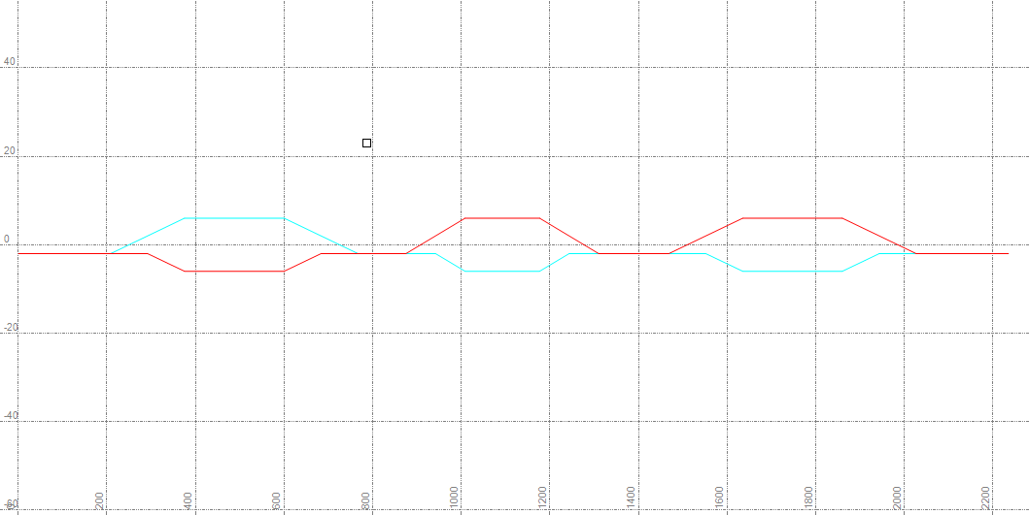
Computing the Reverse & Compound Distances
Note: The Reverse and Compound distances are the smallest distances
between the superelevation elements along the normal cross slope line
Reverse
Maximum Distance
Compound Maximum Distance

Slide 12
Rollover Limits
What is a Rollover Limit?
Take an example where normal pavement cross slope is -2%, and normal shoulder cross slope is -4%
The difference between the two slopes is 2% in normal conditions
Without a Rollover Limit at a maximum superelevation of +6% in the pavement section the difference between the two slopes on the high side would be 10% (+6 to -4%) and on the low side would be -2% (-6% to -4%) since the Shoulder is not being superelevated

Slide 13
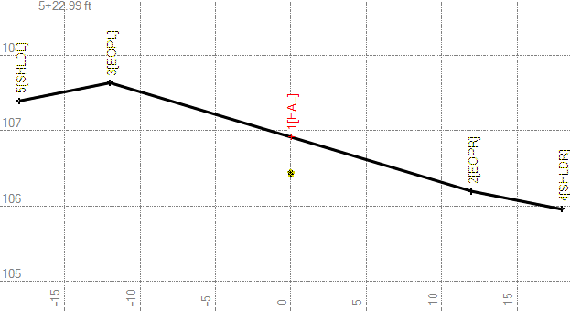
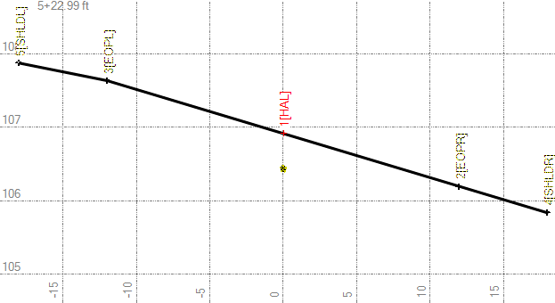
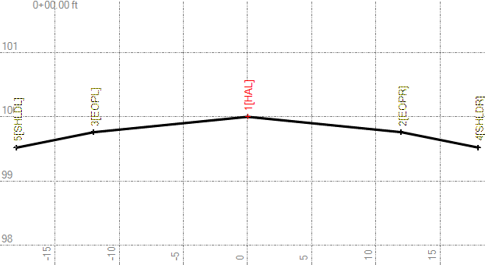
Rollover Limits
Max 2%
1
2
Min 0%
3
(1) Normal Cross Slope Condition
(2) Max Superelevation with No Rollover Limits Set
(3) Max Superelevation with Max 2% and Min 0% Rollover limits Set

Slide 14
Multilane Superelevations
Lane 1
Lane 2
Lane 3
Start of Super
Lane 3 Up
Lane 2 Up
All Lanes Up

Slide 15
Managing Superelevations in TBC v5.0
Create the Alignment – HAL and VAL
Create the Superelevation on the Alignment (this defines the parameters of the superelevation. In itself it does nothing to the corridor model
Create the Corridor Model and define the first Template
Create the Pavement Instructions first – those elements on Left and Right side that are affected by Superelevation
Create a Superelevation instruction for the Left and Right combined or one for the Left and one for the Right if separate controls required. Define the Pivot Node (from the nodes above the super instruction). Define the Affected Nodes (from the nodes above the super instruction).
Define The Shoulder Element instructions Left and Right and at center if a Median Island is present
On the Shoulder Element instructions define the Rollover Parameters to manage the maximum rollovers through a Superelevation

Slide 16
Superelevation vs Slope Tables
Many Superelevations can be managed using instruction slope tables or shareable slope tables – sometimes the data provided makes this an easier approach
Superelevations where the pivot node is on the outside or Inside of the Curve cannot be handled using Slope Tables because through the Super, the centerline pivots higher than the vertical alignment

Slide 17
Helping Yourself Going Forwards
Questions, Answers and Learning Tools
Trimble Community Forum – Civil Construction – BC-HCE Community
https://community.trimble.com/community/find-answers/civil-engineering-and-construction
Training Classes on Video (PC & Mobile Device)
Trimble Library
https://trimble.retrieve.com/#/
Some free classes – some paid for classes

Slide 18
Thank You
To Contact Me
alan_sharp@trimble.com
Use The Forum To Ask Questions On Line – We Will Answer As Fast As Possible – This develops the entire TBC User Community

