Slide 1
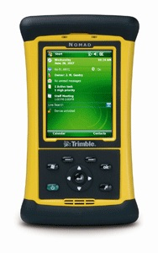
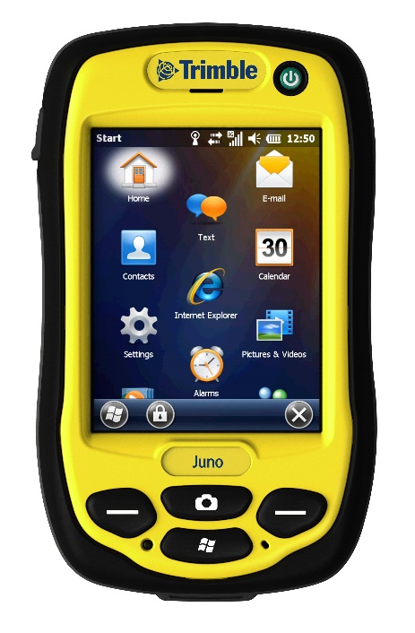
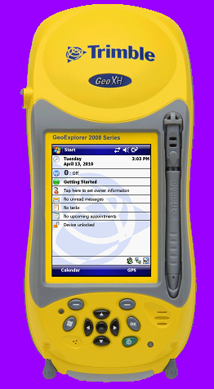
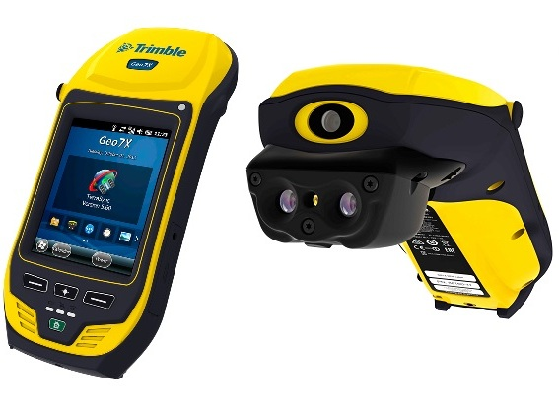
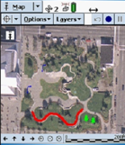
Installing the USB Switcher App
INTRO
Joel Cusick
Alaska Regional Office
NPS
Notes:
Setup: Run on same screen both powerpoints and project via SOTI the GeoXT with live tap.
Will need to have a mobile 5 device with SOTI preloaded. Version on laptop and connected to device via cradle. Use XT skin. Then place powerpoint without any toolbars on one side of screen and SOTI projected on other.
Planned Time: 45minutes
Class has returned from the field for the first time. Now class participants need to transfer from the field devices, GPS recievers all the data collected in SSF file format to the PC. At a minimum this requires the same Active Sync connection, cradle, and cable. At least one SSF and Almanac will be transferred.

Slide 2
Teams Video and Audio – Mute or Unmute!

Slide 3
Course Outline - April 2020
Session 1. Enabling the USB Switcher app and bypassing WMDC using SD cards
Session 2. Installing Positions and Overview of Workflow (ArcMap 10.7.1 and Positions required)
Session 3. Edit AKR_CORE DDF - download and edit a data dictionary
Session 4. Field Day!
Session 5. Process field data including differential correction and confirm coordinates*
*This session will be 2 hours in duration

Slide 4
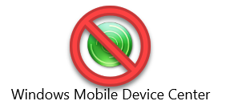
Session 1 – Enabling the USB Switcher app
Sets the stage for allowing data transfer to and from a Windows Mobile device bypassing WMDC
Allow Check Out and Check In workfklows to a Trimble using Trimble Positions Desktop
In later sessions we will depend on USB Switcher app to connect and SEND a DDF to the Trimble and RECEIVE a SSF from a field exercise
We are going to demonstrate cutting out Pathfinder office altogether working from ArcMap

Slide 5
Why Bother?
WMDC is not being maintained by Microsoft hence a security risk
Files have to pass to/from a Trimble – Bluetooth is possible, but its not easy
Leverage you Park investment – FREE!. software, device is with no maint. fee
TerraSync provides hi-accuracy collection including sensitive data collection and ensures your tied to the NSRF – in anticipation of a datum switch in 2022
Persistent connection and secure way to store data on a card with no interruption or changes to file handling in either PFO or Positions.

Slide 6
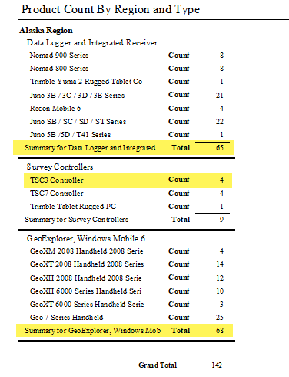
AKR’s Significant Investment
Windows Mobile devices are dependent on this workflow for this FY
These devices represent the highest accuracy, most reliable, ruggedized geospatial tools in AK

Slide 7
Old but Good School

Slide 8
Lets Go!
Install USB Switcher App
*Nomads and 2008/3000 series will not run the App. Manual transfer only.
Notes:
Setup: Run on same screen both powerpoints and project via SOTI the GeoXT with live tap.
Will need to have a mobile 5 device with SOTI preloaded. Version on laptop and connected to device via cradle. Use XT skin. Then place powerpoint without any toolbars on one side of screen and SOTI projected on other.
Planned Time: 45minutes
Class has returned from the field for the first time. Now class participants need to transfer from the field devices, GPS recievers all the data collected in SSF file format to the PC. At a minimum this requires the same Active Sync connection, cradle, and cable. At least one SSF and Almanac will be transferred.

Slide 9
Questions Before We Get Started?

Slide 10
How to Install the USB Switcher App to Bypass WMDC
Windows Mobile
Notes:
Setup: Run on same screen both powerpoints and project via SOTI the GeoXT with live tap.
Will need to have a mobile 5 device with SOTI preloaded. Version on laptop and connected to device via cradle. Use XT skin. Then place powerpoint without any toolbars on one side of screen and SOTI projected on other.
Planned Time: 45minutes
Class has returned from the field for the first time. Now class participants need to transfer from the field devices, GPS recievers all the data collected in SSF file format to the PC. At a minimum this requires the same Active Sync connection, cradle, and cable. At least one SSF and Almanac will be transferred.

Slide 11
USB Switcher app replaces Windows Mobile Device Center
USB Switcher app bypasses the deprecated WMDC / Active Sync connection to Windows Mobile devices
Allows connection thru the Data Transfer Utility
USB Switcher App exposes the Trimble as a Device

Slide 12
Allows Data Transfer to a WM Device using Trimble Positions Desktop
Later sessions will dive into using Trimble Positions to check out DDF from a GDB and Check data back into the GDB from the field
We are going to demonstrate cutting out Pathfinder office altogether working from ArcMap
USB Switcher App allows this data transfer to occur

Slide 13
Positions is the office Software for processing terrasync data
Positions Desktop Add-in for Arcmap is used to:
Integrate post-processing of SSF files inside geodatabases
Avoids traditional shapefile/fGDB export from Pathfinder Office
Appends feature level GNSS metadata
Integrates high accuracy GPS, including vertical
https://www.youtube.com/watch?v=DsweW0K79i0&t=1914s

Slide 14
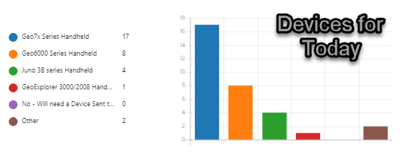
Demos Today
Using a Juno 3B/Geo7X
Using a GeoExplorer 6000 series
Using a GeoExplorer 3000/2008
https://doimspp.sharepoint.com/sites/npsgnssposnav/SiteAssets/SitePages/resources_trimble/USB%20Switcher%20App%20Installation.pdf

Slide 15
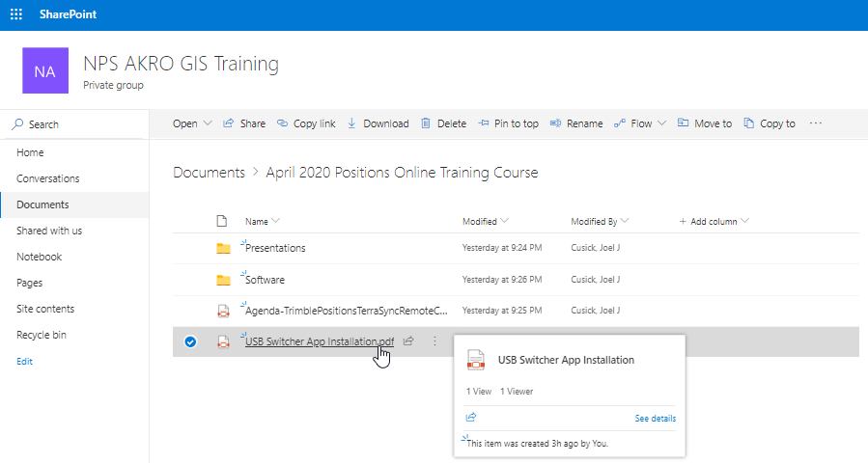
Follow Along
Using the USB Switcher App Installation.pdf
Watch me and/or take notes on the steps in PDF

Slide 16
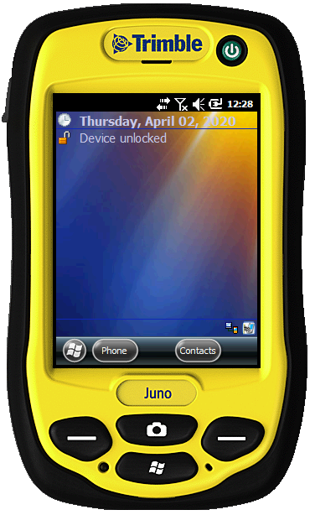
Applies to Following Devices
Juno 3X Series
Geo7x Series
TSC3 (Survey Controller)

Slide 17
Download Software and Copy Files to a SD Card
Download the USB Switcher App Zip file by copying this link in your browser
http://trl.trimble.com/dscgi/ds.py/Get/File-871020/UsbSwitcher.zip
Extract files
Copy the folder “USBSwitcher” to the root of SD Card

Slide 18
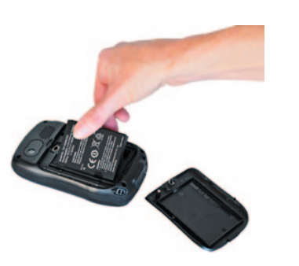
Insert micro SD Card into Trimble
Juno - Micro SD slot located under the battery
Geo7x – Under rubber door, right side

Slide 19
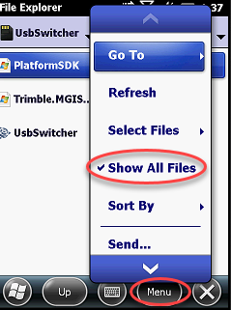
Set File Explorer on Trimble to Show All Files
Launch File Explorer from Windows icon
Error in copying files may result in USB Switcher app not functioning
Show all Files ensures you copy all files

Slide 20
Copy Files onto Trimble’s My Device
Insert SD card into Trimble
Navigate to storage card
Tap / hold using the stylus on “USBSwitcher”
Select Copy
Switch to My Device (upper left)
Press Menu. Scroll to bottom, Edit / Paste
Next step requires you to disconnect the Trimble to the PC/laptop

Slide 21
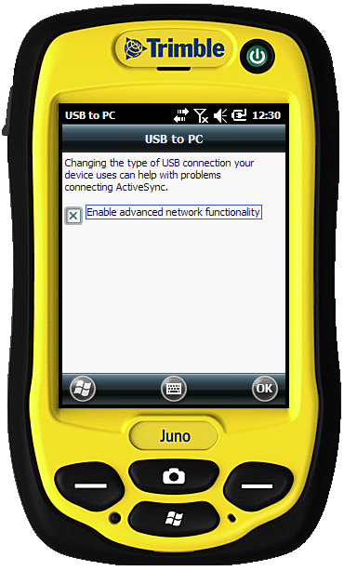
Check Settings
Disconnect Trimble from PC!
Enable Advanced Network Functionality on the Trimble
Tap Windows / Settings / Connections / USB to PC
Tap OK

Slide 22
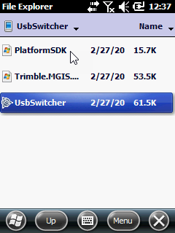
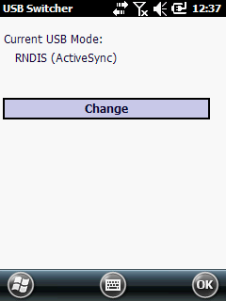
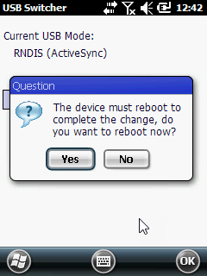
Run USBSwitcher
Tap Change Reboot

Slide 23
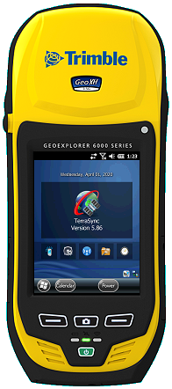
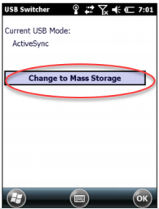
Check USBSwitcher - Mass Storage
Might have to run twice!
Tap Change Reboot

Slide 24
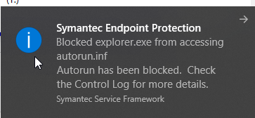
Mass Storage Means USB!
Connect USB cable to PC
Turn sound on and you should see/hear a connection
Open a Windows Explorer
This window should pop up

Slide 25
Applies to Following Devices
GeoExplorer 6000 Devices
One extra file is needed for USB Switcher App to run

Slide 26
Download Software and Copy Files to a SD Card
USB Mass Storage CAB file from http://trl.trimble.com/dscgi/ds.py/Get/File-936346/USB_MS.zip
Copy the file “USB_MS.cab” to the root of SD Card

Slide 27
Download Software and Copy Files to a SD Card
Download the USB Switcher App Zip file by copying this link in your browser
http://trl.trimble.com/dscgi/ds.py/Get/File871020/UsbSwitcher.zip
Extract files
Copy the folder “USBSwitcher” to the root of SD Card

Slide 28
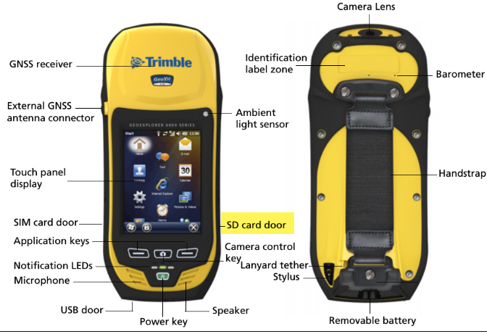
Insert SD Card into Geo6000
Standard SD slot located under rubber door, right side

Slide 29
Set File Explorer on Trimble to Show All Files
Launch File Explorer from Windows icon
Error in copying files may result in USB Switcher app not functioning
Show all Files ensures you copy all files

Slide 30
Copy Files onto Trimble’s My Device
Insert SD card into Trimble
Navigate to storage card
Tap / hold using the stylus on “USB_MS.cab” Select Copy
Switch to My Device (upper left)
Press Menu. Scroll to bottom, Edit / Paste

Slide 31
Copy Files onto Trimble’s My Device cont.
Navigate to storage card
Tap / hold using the stylus on “USBSwitcher”
Select Copy
Switch to My Device (upper left)
Press Menu. Scroll to bottom, Edit / Paste
Next step requires you to disconnect the Trimble to the PC/laptop

Slide 32
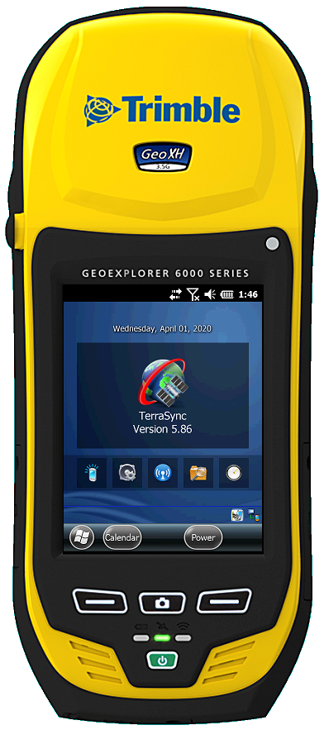
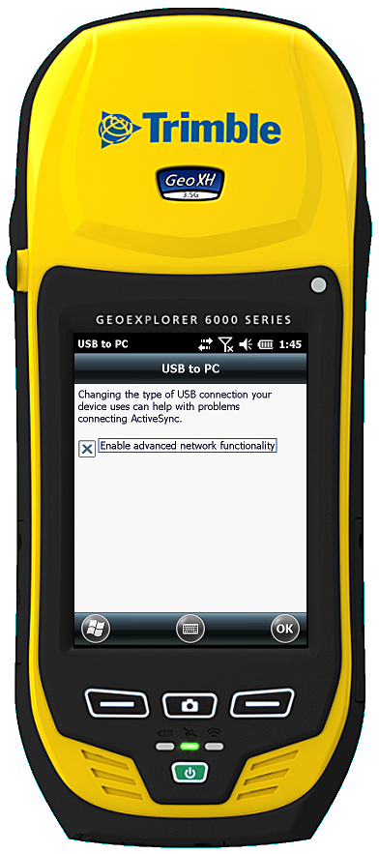
Check Settings
Disconnect Trimble from PC!
Enable Advanced Network Functionality on the Trimble
Tap Windows / Settings / Connections / USB to PC
Tap OK

Slide 33
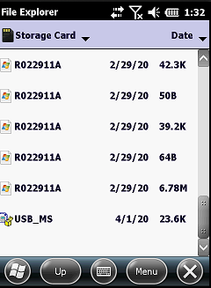
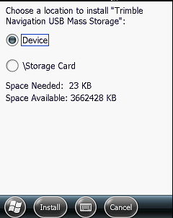
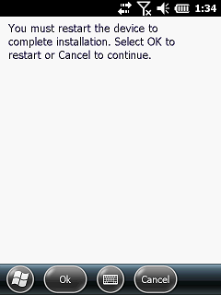
1. Run USB_MS.cab
Tap Device Restart

Slide 34
2. Run USBSwitcher
Tap Change Reboot

Slide 35
3. Check USBSwitcher - Mass Storage
Might have to run twice!
Tap Change Reboot

Slide 36
Mass Storage Means USB!
Connect USB cable to PC
Turn sound on and you should see/hear a connection
Open a Windows Explorer
This window should pop up

Slide 37
Applies to Following Devices
GeoExplorer 2008 Series
GeoExplorer 3000 Series
One of the oldest in our fleet but very high accuracy

Slide 38
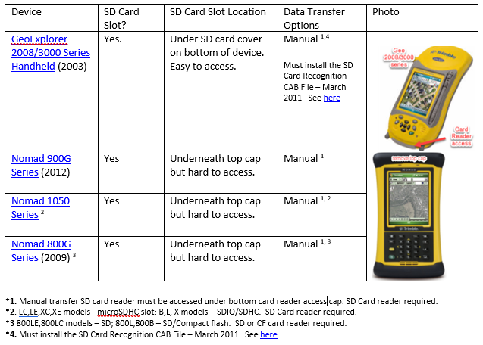
Geo2008/3000

Slide 39
Geo2008/3000
Manual transfer of files are required
SD Card reader required
Manual transfer SD card reader must be accessed under bottom card reader access cap
Download the SD Card Recognition CAB File – March 2011 See https://www.trimble.com/globalTRLTAB.aspx?Nav=Collection-57323

Slide 40
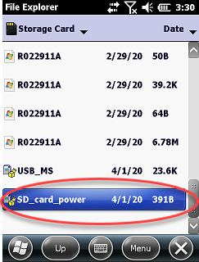
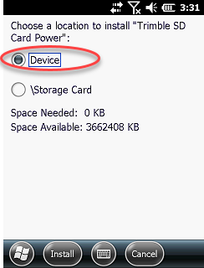
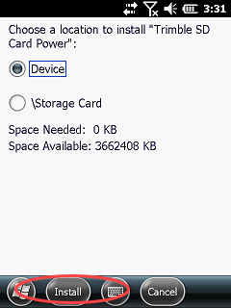
Geo2008/3000
Copy the SD_card_power.CAB copied to SD Card
Insert SD card into Geo 2008/3000. Tap file and select device / Install
Tap Device Install

Slide 41
Geo2008/3000
Once Cab file is installed the Geo 2008/3000 can read/write to SD card

Slide 42
Tips – Failing to Connect
Run the USB switcher app twice!
Check you are not connected to Trimble during steps
Check Advanced Network Functionality – X
Check that all 3 files are located together to run the USB Switcher App (show all files)
Remove SD card from Trimble, reinsert
Is Device current with OS/FW?
In extreme cases a Hardware Reset is required – but this will remove TerraSync which requires WMDC to install!

Slide 43
Summary
Connected successfully two different Trimble devices to a computer using the USBSwitcher app – Juno/Geo7X and a GeoExplorer 6000
Demonstrated how to ensure the SD Card can be recognized with the GeoExplorer 3000/2008 series for manual data transfer
You are now ready for Session 2 – See you on April 8!

Slide 44
Course Outline - April 2020
Session 1. Enabling the USB Switcher app and bypassing WMDC using SD cards
Session 2. Installing Positions and Overview of Workflow (ArcMap 10.7.1 and Positions required)
Session 3. Edit AKR_CORE DDF - download and edit a data dictionary
Session 4. Field Day!
Session 5. Process field data including differential correction and confirm coordinates*
See you on April 8 for Session 2
Be sure to have both ArcMap and
Positions installed!
*This session will be 2 hours in duration

Slide 45
Installing the USB Switcher App
Joel Cusick
Alaska Regional Office
NPS
Notes:
Setup: Run on same screen both powerpoints and project via SOTI the GeoXT with live tap.
Will need to have a mobile 5 device with SOTI preloaded. Version on laptop and connected to device via cradle. Use XT skin. Then place powerpoint without any toolbars on one side of screen and SOTI projected on other.
Planned Time: 45minutes
Class has returned from the field for the first time. Now class participants need to transfer from the field devices, GPS recievers all the data collected in SSF file format to the PC. At a minimum this requires the same Active Sync connection, cradle, and cable. At least one SSF and Almanac will be transferred.

