Slide 1
2018
Trimble Dimensions
User Conference
November 5–7
The Venetian / Sands Expo Center – Las Vegas
CEC-1457

Slide 2
Using Scripting Tools to Enhance TBC Workflows
(For Budding Developers)

Slide 3
TBC v5 Now Includes Macro Language Support
Based on IronPython (Python for .NET)
Allows end users to extend TBC by adding new “Commands”
Called “TML” ☺ (but nothing like TML in Terramodel)

Slide 4
What is IronPython?
The Python programming language for the .NET Framework
It’s open source
Member of .NET Foundation
Very good support in VS 2017 (Visual Studio)
Easy access to .NET objects (like the ones in TBC)
Uses “Dynamic Language Runtime” feature in .Net
Direct support for Windows Presentation Foundation (WPF)
Generates IL code, so performance is good

Slide 5
What can a macro do?
Each macro (Python file) defines a new command.
These “macro commands” are treated exactly like the built-in commands. From users point of view, no difference.
Macro commands can include an icon.
Macro commands can be placed on a toolbar ribbon.
Macro commands have access to all objects in the TBC model.
Macro commands can do clever or stupid stuff. It’s up to you ☺

Slide 6
Licensing…
TBC Licensing has been changed for v5
Macros enabled if user has “Survey Advanced” (or higher license)

Slide 7
How Commands are Added to TBC
Command discovery at startup
Searches C:\ProgramData\Trimble\MacroCommands
Any *.py file found with function named “Setup” (with two arguments) will be treated as a command (if property “Key” defined)
The function “Setup” defines the command properties.
(By setting the properties in “cmdData” class.)
A simple 2 line macro (which does nothing)
def Setup(cmdData, macroFileFolder):
cmdData.Key = "_DoesNothing"
Only required data is command “Key” property. If not defined, file is ignored.

Slide 8
TBC has 4 types of cmds
A command performs a specific function in TBC
No UI (Select All, Zoom Extents)
UI using modal dialogs (Project Settings, Options, …)
UI hosted in Command Pane (Typical location)
UI hosted in MDI view (Spreadsheet views)
May be accessed from
Menu
Ribbon/Quicklaunch
Command toolbar
Context menu
Command Pane
Command line, Recent Commands list, All Commands list
Within code
A TML can create all four types of commands!

Slide 9
How it Works
A dictionary of file names and command data is created in “..\MacroCommands” and all subfolders (with *.py files). Name is “<folder>.dict”
Command data holds file modify date
If modify date of file does not match, file is compiled (and Setup function called) and then command is added to command list
If dates match, command is added but not compiled. File will be compiled the first time the macro is used. Very small effect on program startup time

Slide 10
How it Works
When command is executed:
If function “Execute(cmd, currentProject, macroFileFolder, parameters)” is defined, it will be called when command is run.
Usually use this method to pop up dialog boxes or run commands that don’t require UI.
If macro defined UIForm property (in command data at startup), then C# command class is created and macro assigned
If macro defined UIViewForm property (in command data at startup), then C# view class is created and macro assigned

Slide 11
Getting started writing macros
Install Visual Studio (Community edition is fine)
Version 15.8 and above is best
https://www.visualstudio.com/free-developer-offers/
Include “Python development” option when installing
Install IronPython (version 2.7.9)
http://ironpython.net/download/
Install Trimble Macros SDK
Available from Trimble Community (“Macro” section)
Actually, these are all optional. The python file is just a text file, so you could just use Notepad.exe

Slide 13
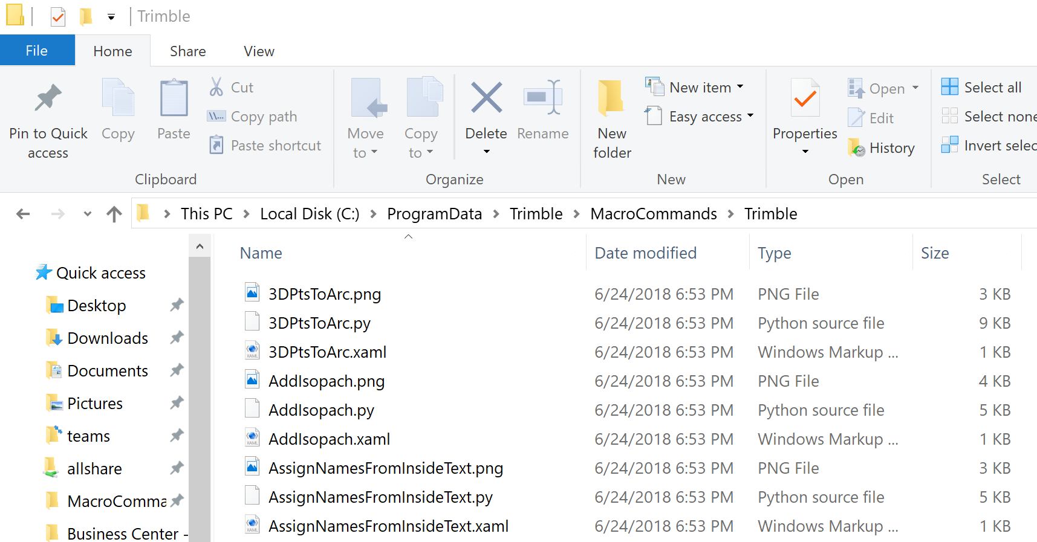

Slide 14
My First Macro
Two options for macro folder location (so TBC finds new macro)
Put VS project in “C:\ProgramData\Trimble\MacroCommands”
TBC will find macro next time it starts
Add system environment variable named “TBC_MacroPath2”
Value should be path to VS project folder. This folder is added to list of folders searched by TBC.
Restart Visual Studio after creating the variable.

Slide 15
Creating a Visual Studio Project
This example will put project in the “MacroCommands” folder. (see previous slide)
From File menu, select “New”, then “Project”
From “Other Languages”, select “Python”.
If “Python” missing, update your Visual Studio install and select the Python option.
Select “TbcMacros” template from Python group.
This will set required reference files
If this template missing, install “Trimble Macros SDK”.

Slide 16
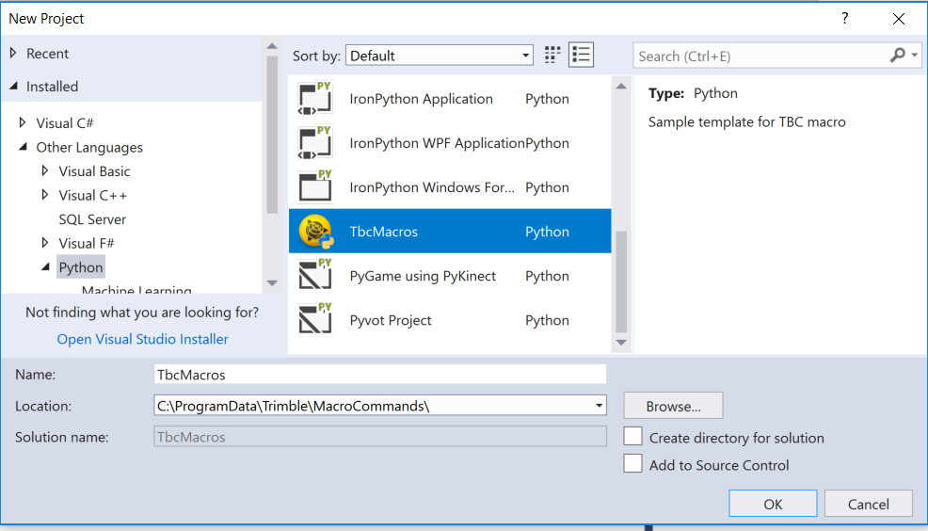
Enter path to macro folder for project “Location”
Uncheck “Create directory for solution”

Slide 17
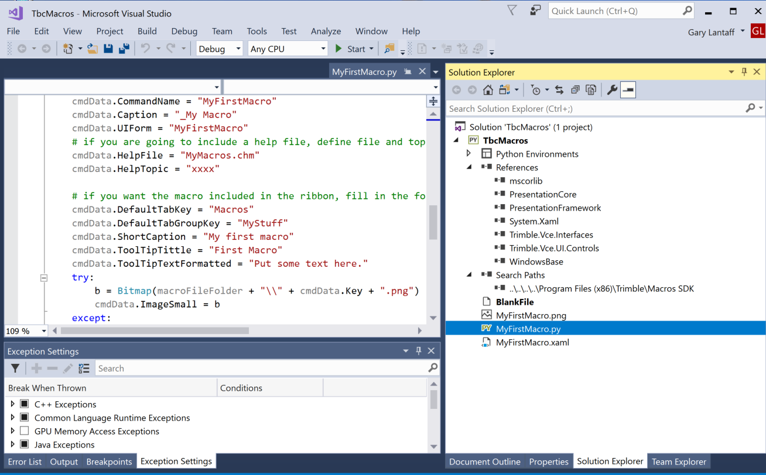
That’s it.

Slide 18
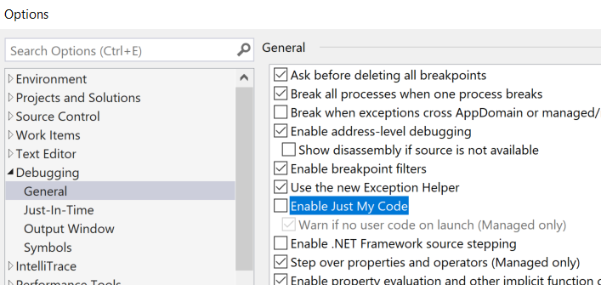
Helpful hint
Turn off debugger option to enable “Just My Code” (since python code called from non-debug code)

Slide 19
Properties of Macro Commands
Assigned when Setup function called
Key
Used to uniquely identify command
Used to run command from code or command line
Case insensitive, Not localized
Cannot contain white space or control characters
Command Name (defaults to Key)
Usually just translated “Key”
Command Caption (defaults to Name)
Usually just command name with “spaces”. “DoX” > “Do X”
ImageSmall (if you place the cmd on ribbon)

Slide 20
Properties continued…
HasStartup
If True, function “SetupExecute()” will be called on application start. (No project loaded at this time).
EnableNoProject
If true, command is always enabled
UIForm
Name of Class that defines UI controls when command shows UI in command frame. Just leave as empty string if cmd does not use command frame UI
HelpFile (if you want to include “Help” for macro cmd. Need to define “HelpTopic” also)
Hidden (if you want to “Hide” the cmd. Must key in command name to run.)

Slide 21
Properties continued…
UIViewForm
Name of Class that defines UI controls when form shows in MDI view (like PointsSpreadsheet). Just leave as empty string if not used.

Slide 22
“Dialog Box” Style Commands
Just show dialog in Execute function
Can create window directly or create class that inherits from Window
WPF will automatically generate properties for each named control

Slide 23
Typical Docked Command
A “helper” class is created that holds the basic framework of the command. This “host” command uses WPF for UI layout.
The xaml file has a grid control with a stacker panel for the macro command’s use.
The macro must define a class that inherits from the WPF StackPanel control
Use wpf.LoadComponent to read xaml file and create UI controls

Slide 24
Predefined Functions
Several predefined functions are available from the “Host” command. If the function is defined by the macro, it will be called.
OnLoad(MacroCmdUI, okBtn, cancelBtn, EventArgs)
CancelClicked(MacroCmdUI, RoutedEventArgs)
OkClicked(MacroCmdUI, RoutedEventArgs)

Slide 25
Adding TBC Custom Controls to Toolbox
Custom controls are used to enable advanced UI features
TBC has custom controls for entering a coordinate, distance, layer, angle, etc….
From designer, open Toolbox tab
Select the “General” section (as we want the TBC controls to be listed here.
Right-click and select “Choose Items…” option
On the “WPF Components” tab, press the “Browse…” button
Browse to “C:\Program Files (x86)\Trimble\Macros SDK” and select file “Trimble.Vce.UI.Controls.dll”
Press “OK” to import all the WPF controls required.

Slide 26
Adding Macros to the Ribbon
The command key and image are stored in the ribbon. If you change the image (or caption), you need to reload the toolbar ribbon for changes to be included. (By using the “Reset Defaults” option in the SetRibbonTabs cmd)
TBC only looks for changes when the py file is newer than the date saved in the “*.dict” file. If you only change the command icon, you need to resave the python file or delete the *.dict file (which would be rebuild on next start of TBC)

Slide 27
Command Properties for Ribbon
DefaultTabKey (Ribbon tab to use)
DefaultTabGroupKey
InsertAfterMenuToolKey
The key of a tool after which the command is inserted. If the value is an empty string, the tool is inserted as the first item in the menu If the value is null or the key is not found, the tool is added to the end of the menu.
QuickAccessMenuLocation
ShortCaption
DescriptionOnMenu
ToolTipTextFormatted
ToolTipTitle

Slide 28
Live Demo
Install tools
Create VS project
Edit/Rename default macro
Use Object Browser to see properties of objects
Use VS to debug the macro

Slide 29
Security (of Macro)
Can save compiled code (IL) to .NET DLL
Download macro “ConvertToDll” from Community
Key in “_ConvertToDll” in command pane
File extension is *.pydll
We look for either *.py or *.pydll when scanning
Will use “newer” file if both *.py and *.pydll found
Can embed “xaml” code in DLL (so only the pydll file required to run) See macro QuickLine.py for example

Slide 30
Thank You

